Slide 1
2010 Professional Reliance
Survey
Mike Larock, RPF
Association of BC Forest Professionals
Professional Reliance Workshop
Williams Lake
March 9, 2011

Slide 2
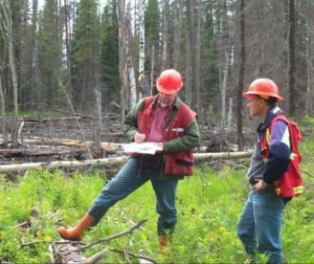
Overview
Background
Survey Contents
Survey Respondents
Responses and key findings
Summary and Conclusions

Slide 3
Purpose of Survey
Support Advancing Professional Reliance
Assess current understanding and application of PR
Identify barriers and opportunities to PR
Guide development of workshops
Provide a baseline for measuring success
Notes:
Support Advancing Professional Reliance (PR) Strategy – 1st prong of 3 prong approach
Measure current understanding and application of PR - quantitative and qualitative assessments
Also the survey itself served to increase awareness and understating of PR
Identify barriers and opportunities to PR – for further discussion
Guide development of workshops – focus content and topics for discussion
Baseline for future surveys – measure improvements when conducted again in 1-2 years

Slide 4

Background
1st draft by RSI Operational Issues Forum (OIF) team
Provincial team - collaboration by
MFR, Licensees, and ABCFP.
SurveyMonkey
Invitations to resource professionals
Open Sept. 7 to 26, 2010
Anonymous entries

Slide 5
Survey Contents
7 Sections: 127 statements + comments
Respondent Information
Understanding of PR *
Application of PR *
ABCFP *
Personal Professional Practice †
Plans and Submissions *
Training and general comments
* agreement † frequency
Notes:
Report was divided in to 6 sections.
Respondent information, including identification by region and employer – e.g. coast, north, south; and government, industry or consulting/ independent
Understanding of PR – which sought personal opinions on knowledge of PR and the desired outcomes
Application of PR – views on how PR is being applied at work and to different business areas.
ABCFP – views on the role of association in guiding/upholding professional practices and holding member accountable
Personal Professional Practice – based in part on the ABCFP bylaws and Standards of Practice
Plans and Submissions – those submitted to government for approval
Sections 2, 3, 4, and 6 consisted of a series of statements, which respondents were asked to score based on a agreement scale (stongly agree to strongly disgree). Secton 5 – personal professional practice – consisted of statements which respondents were asked to score on a frequency scale – how often the respondent did something (always to never).
There were a total of 125 statements or questions in the survey, plus a number of comments fields. Not all statements were applicable to all, depending on responses provided to previous statements or questions.

Slide 6
Survey Respondents
1425 Respondents & 1900 Comments
RSI | RNI | RCO | Victoria
49% | 34% | 31% | 10%
BC Govt | Licensees | Consultants | Other
55% | 24% | 18% | 3%
RPF | RFT | FIT | PEng PAg RPBio Others
63% | 30% | 3% | 10%
Notes:
1425 respondents – but not all completed survey or all sections of the survey
By region: RSI 49%; RNI 34%; RCO 31%; HQ 10% - a number of respondents indicated they worked in more than one region.
By employer: BC Govt 55%; Licensee 24%; Consult 18%
By profession: 96% members of ABCFP. Based on 1400 responses, ~1/4 of the association – good response rate. Others included PEng, PAgs, RPBio, (1% each) 4% not professional, 3% other. - - some more than one profession so total is higher than 100%

Slide 7
Coloured mean score tables
 | Southern Interior Forest Region
Section 2. Understanding Professional Reliance | SIFR | Consultants | Tenure holders | BC Govt
 | Mean | Mean | Mean | Mean
8. I understand the meaning and application of professional reliance in the context of managing BC’s forest and range resources. | 80 | 79 | 84 | 77
9. I understand how forest professionals are held accountable to each other, their association, their employers and the public. | 77 | 81 | 85 | 70
10. I can readily access or find information regarding professional reliance, accountability and practices. | 73 | 74 | 79 | 70
11. I know whom to consult should I have questions regarding professional reliance, accountability and practices. | 71 | 72 | 75 | 67
12. I have a good understanding of the respective roles and responsibilities of government, licensees, and professionals that combined constitute the professional reliance system. | 68 | 64 | 73 | 67
13. I understand the differences between the legal obligations of professionals vs. the legal obligations of tenure holders. | 73 | 75 | 78 | 69
14. PR is a shared responsibility of government, licensees, and professionals (including the ABCFP). | 78 | 82 | 86 | 72
15a. PR will reduce transaction costs. | 63 | 65 | 72 | 56
15b. PR will Lead to more efficient processes (e.g. plan submission and approvals. | 67 | 70 | 80 | 59
15c. PR will lead to more efficient use of resources. | 61 | 65 | 76 | 50
15d. PR will lead to more innovative practices. | 59 | 66 | 70 | 49
15e. PR will lead to more effective application of risk management. | 60 | 64 | 73 | 50
15f. PR will improve stewardship . | 49 | 57 | 66 | 35
15g. PR will increase public understanding, confidence and trust in professionals. | 46 | 50 | 60 | 36
    Ave. scores based on:
    100 = Strongly disagree 75 = Agree 50 = Neutral
    25 = Disagree 0 = Strongly Disagree

Slide 8
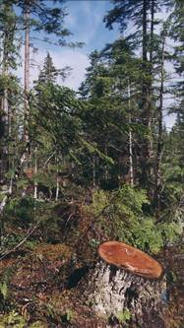
Responses and Key Findings
S. 2 – Understanding PR
Personal Understanding of PR - High
PR is a Shared Responsibility - High
Desired outcomes of PR – Variable
  Application of Risk
  Stewardship
  Public confidence and trust
      Industry – Higher
      Consultants – Mid
      Govt – Lower
Notes:
Respondents were varied about understanding and knowledge about professional reliance.
Considerable disagreement /divergence of respondents by employer group across all regions on desired outcomes
Effective use of resources
Innovative practices
Effective Application of Risk Management
Improve Stewardship
Increase public confidence
Desired outcomes *Government - Low
Consultants - Medium
Industry - High

Slide 9
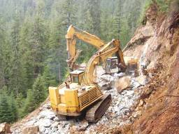
Responses and Key Findings
S. 3 – Application of PR
Similar scores across employer groups
Trust and working relationships – Low
Professional Competence – High
but biased to one’s own employer group
Application of PR in business areas
  Engineering – High
  Stewardship - Mid
  Cruise and Appraisals – Low
  Monitoring - Low
Notes:
This section was not rated very high – but there was more consistency between the employer groups.

Slide 10

Responses and Key Findings
S. 4 – Assoc. of BC Forest Professionals
Standards for Accepting Members - High
Accessible information – High
Standards and Guidance - Mid
Assessing Member Competence - Low
Disciplinary process – Variable
  Industry slightly Higher than Govt

Slide 11

Responses and Key Findings
S. 5 – Personal Professional Practice
Based on ABCFP Bylaws and Standards of Practice
High, but contrasts with scores for
s. 3 Application of PR
Areas for improvement:
  Peer reviews
  Document professional
  development and decisions
  Maintain currency in practice
  Bring unresolved issues to attention of the ABCFP (disciplinary process)
Notes:
Respondents asked to score frequency vs satisfaction.
High scores in personal professional practice contrasts with results in Application of PR – which indicates the system isn’t working - or the “other guys” are not upholding the principles of professional practices/reliance.
Notable 20% of respondents indicated they NEVER or only Sometimes seek peer review of work, document professional develop activities or document significant decisions !
Issues resolved between professionals or with third parties, but when respondents have not resolved what they believe to be detrimental forest practices, they are unwilling to bring to attention of ABCFP disciplinary process. This may correspond with lack of satisfaction with the ABCFP disciplinary process

Slide 12
Responses and Key Findings
S. 6 – Plans and Submissions
Variable responses by employer group:
Pressure by reviewer to modify plan
Plan quality:
  clear and understandable
  free of errors and
  omissions
  verifiable and measurable.
Need for rationales –
by submitter and DDM
e.g. “Trust me, I’m an RPF”.
Timing of approvals variable

Slide 13
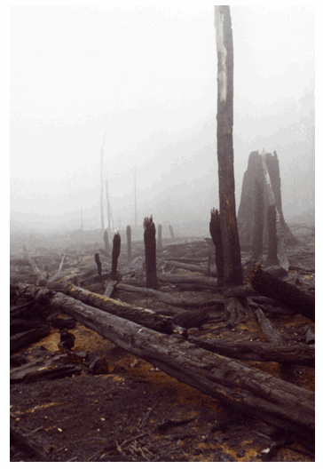
Responses and Key Findings
Comments : Themes and Threads
Reflect lack of....
  understanding and support for PR
  trust between professionals
  “Fox guarding the hen house”
  “Industry manages to bottom-line”
  understanding of different roles & responsibilities (RPF vs. licensee)
  consistency in application of PR
Concerns with...
  quality of work & professional competence
  ABCFP and accountability processes
Notes:
Most comments negative. Not surprising because the survey asked why if you were not satisfied – anonimity.
However, most scores were in agreements – so reflect views on those dissatisfied
Other areas and theme that reflect
perceptions, values and beliefs
Quality of work – and practicing outside one area expertice, competenacies lacking – esp within govt ranks
ABCFP Discplinary process,
Government view of plan and submission quality

Slide 14
Summary
Survey responses and results demonstrate....
High interest in PR – as a topic
Variable understanding & support for PR
Application of PR varies by person, location
and business area.
Consistency between regions by employer groups
Different views based on employer group
- gov’t vs. tenure holder vs. consultant
Notes:
Consistent application – within same office, business area, between offices/districts

Slide 15
Conclusions
To advance PR, we need to....
Improve understanding of PR:
Increase trust between industry/govt
Clarify roles & responsibilities within PR system
Apply PR consistently (where appropriate)
Improve understanding and application of accountability processes (e.g. ABCFP, C&E)

Slide 16
Next Steps
Use results to....
  Advance workshops (interior districts)
  Identify Barriers and Opportunities to PR
  Build PR work plan
Improve (shorten) this year’s survey – Sept. ‘11
Measure, Report and Celebrate Success !
http://www.for.gov.bc.ca/hth/timten/FRPA_implementation/Professional_Reliance.htm

Slide 17

Acknowledgments
The following people made significant contributions to the survey and assessing its results:
Government Industry ABCFP
Ray Crampton Archie MacDonald Mike Larock
Wayne Martin Larry Gardner
John McClary Otto Schulte
Larry Hanlon
Chuck Rowan
Thomas Chen
Brian Barber

